Slide 1
Calculation Of the Phase Diagram Of the Cu-Zn-Sn-S System
Joshua Rogers

Slide 2
Solar Cell Basics
Generally Photovoltaic Solar Cells
Directly generates electricity when light is incident upon it
Simplest Example – Silicon, doped with impurities

Slide 3
Why Solar Cells?
Desire for clean energy
Solar energy is a largely untapped resource
Solar energy provides a potential supply surpassing consumption by three orders of magnitude.
Currently only meets 0.1% of demand.
Notes:
As Such, we need to rapidly develop technologies that will match the necessary power generation abilities.

Slide 4
Possible Setbacks
Cost
Availability
Efficiency
Toxicity

Slide 5
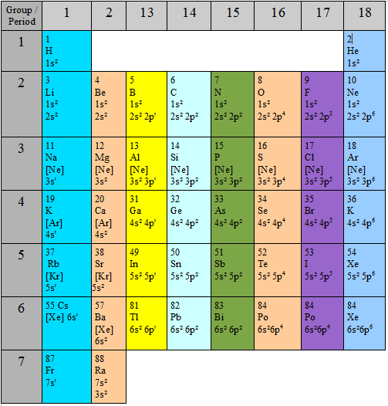
Method of selection
Notes:
Si->CdTe(low Te, tox Cd)->CIGS(cost of indium)->CZTS(low cost, abundant)

Slide 6
CZTS
Geologists have known about the compound for many years
Only Recently considered as PV Cell
Unfortunately in two similar forms
Notes:
kesterite and stannite; one being Zinc rich, the latter Zinc deficient, and with a relatively low crystal energy difference per atom the two structures could coexist. Unfortunately, differentiation of the two structures is difficult due to the disorder of the Cu-Zn cations, which can lead to misidentification.

Slide 7
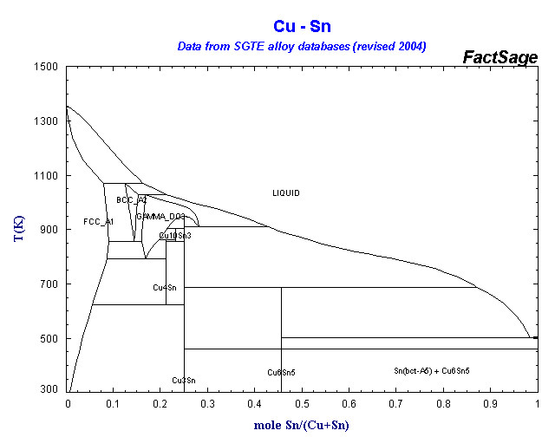
Method of Calculation

Slide 8
Gibbs Free Energy
Required Equation:
ΔG^{Reaction} = (ΔG_{Formation} +ΔG) ₁-(ΔG_{Formation}+ΔG) ₂

Slide 9
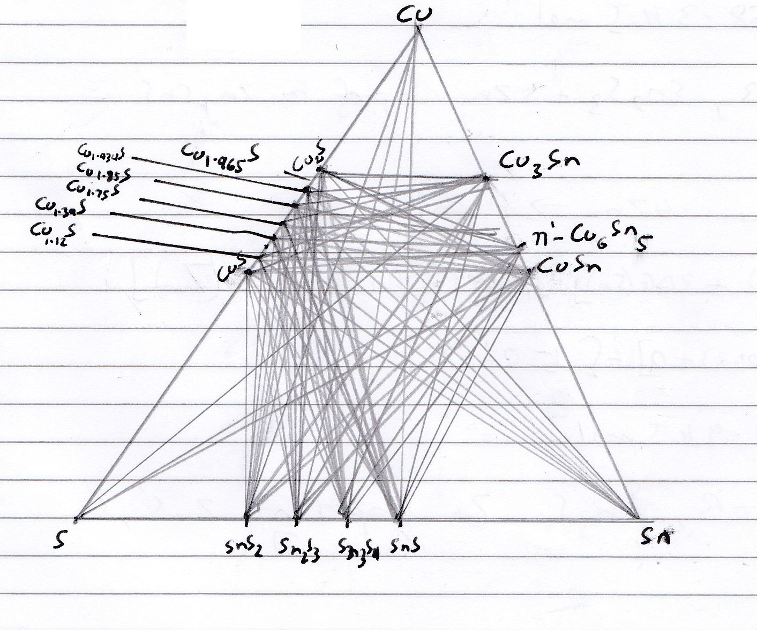
Ternary Phase Diagrams

Slide 10
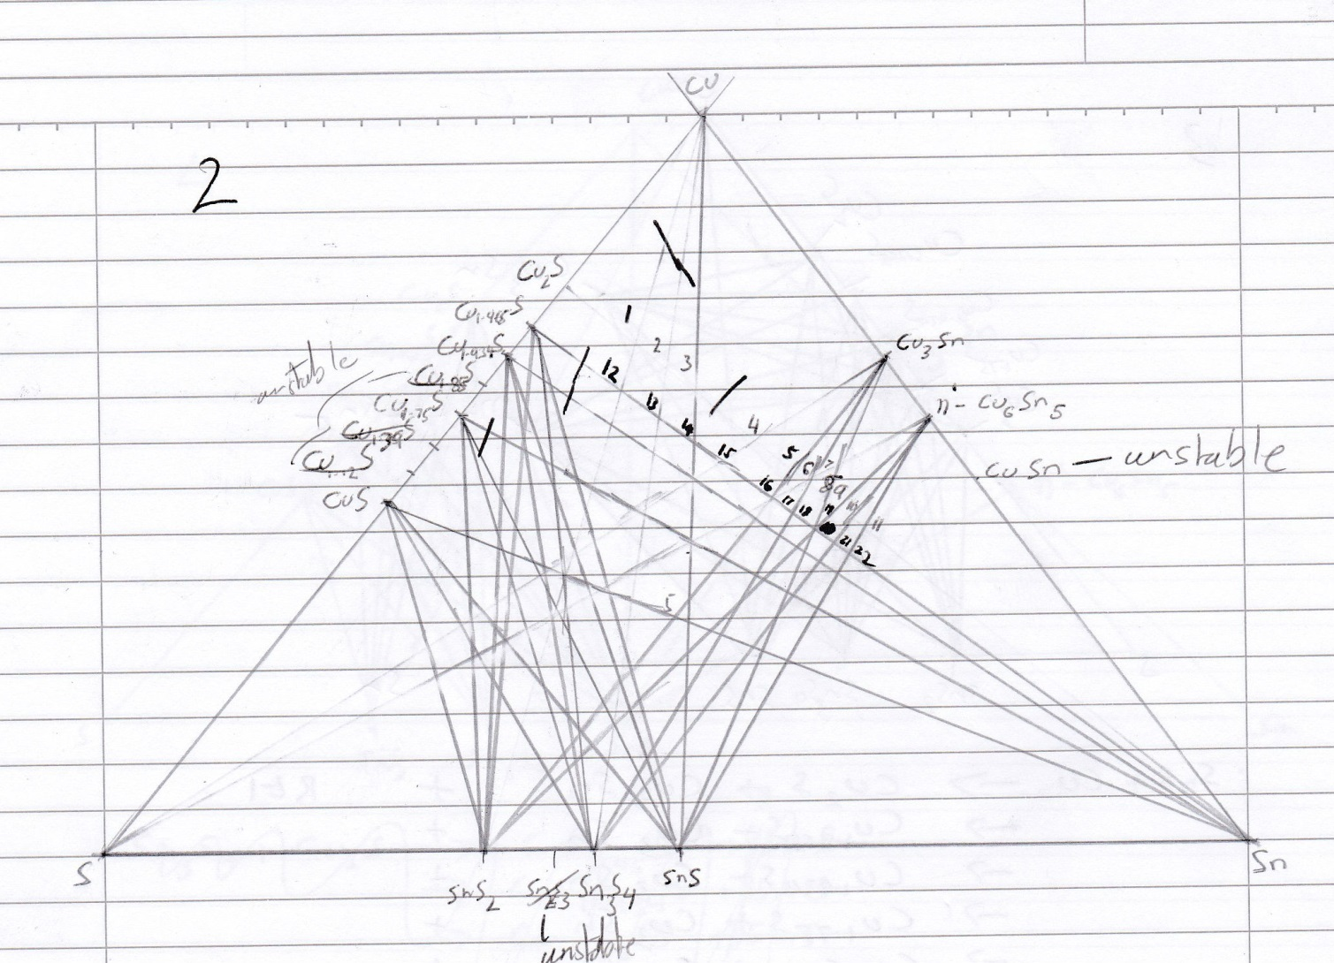

Slide 11
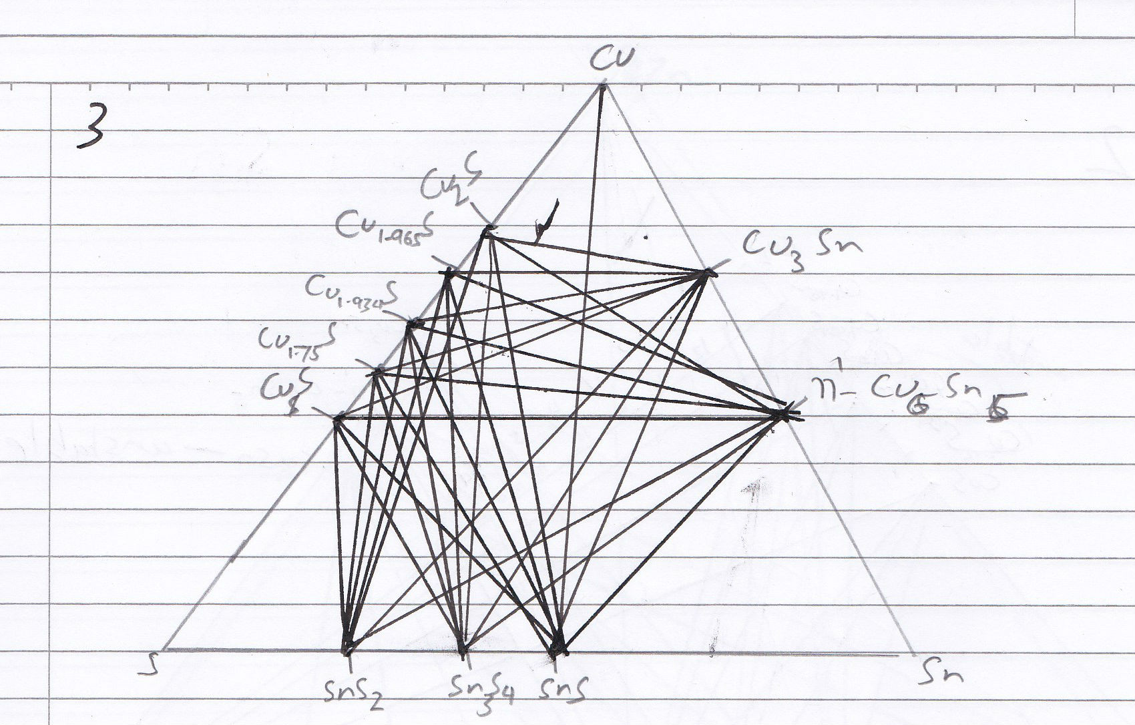

Slide 12
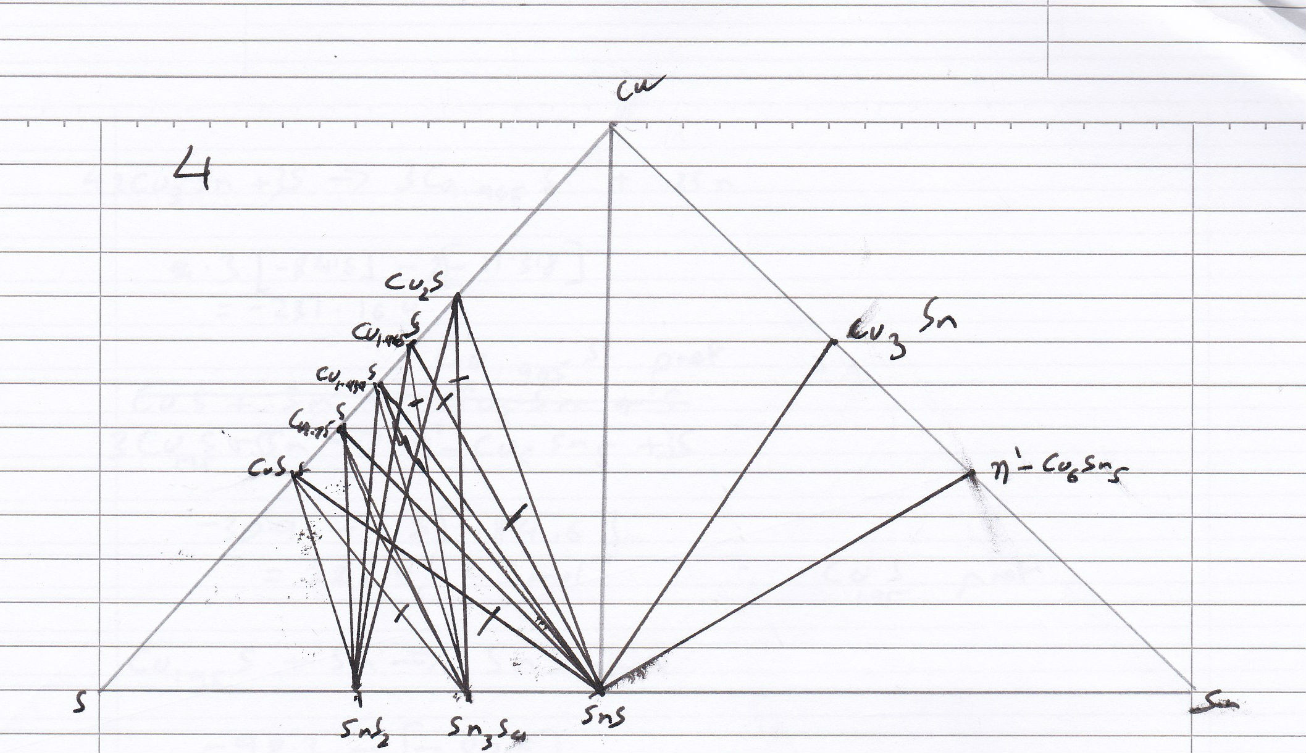

Slide 13
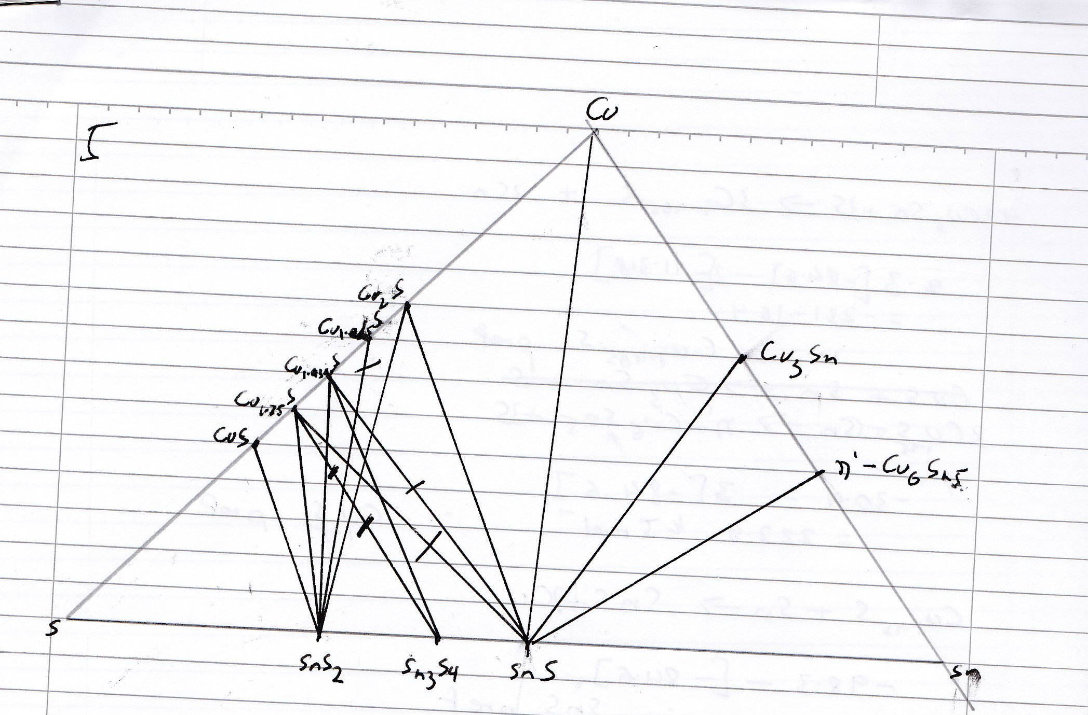

Slide 14
